Slide 1
Not Everyone is Excited:
Protecting 3D Printing and
Open Hardware
in Washington, DC
Michael Weinberg

Slide 3
DMCA

Slide 4
3D/DC

Slide 5
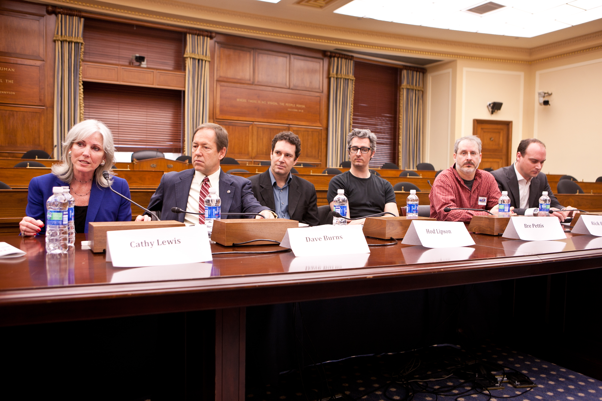

Slide 6
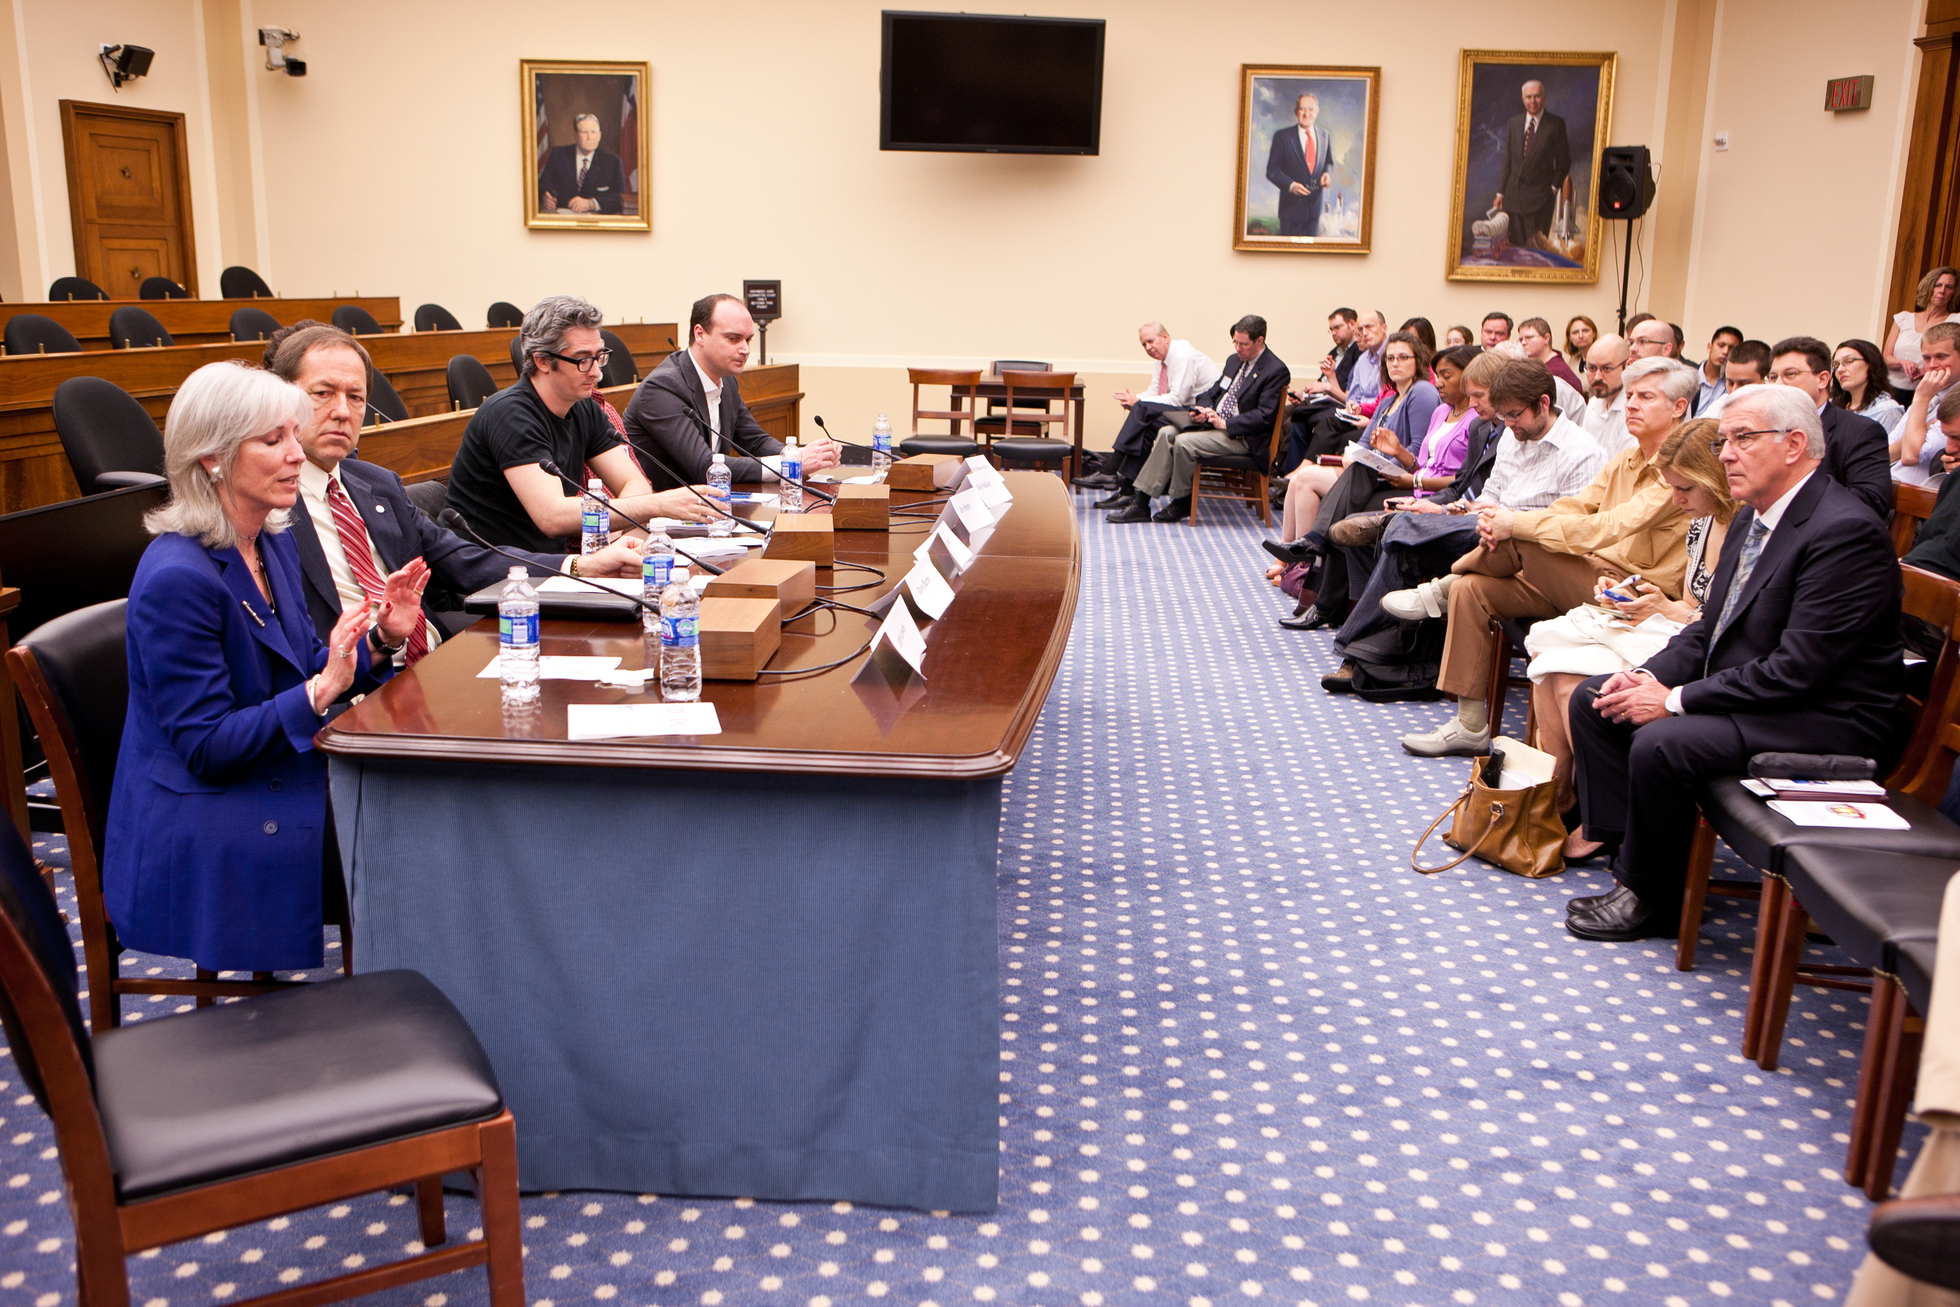

Slide 7
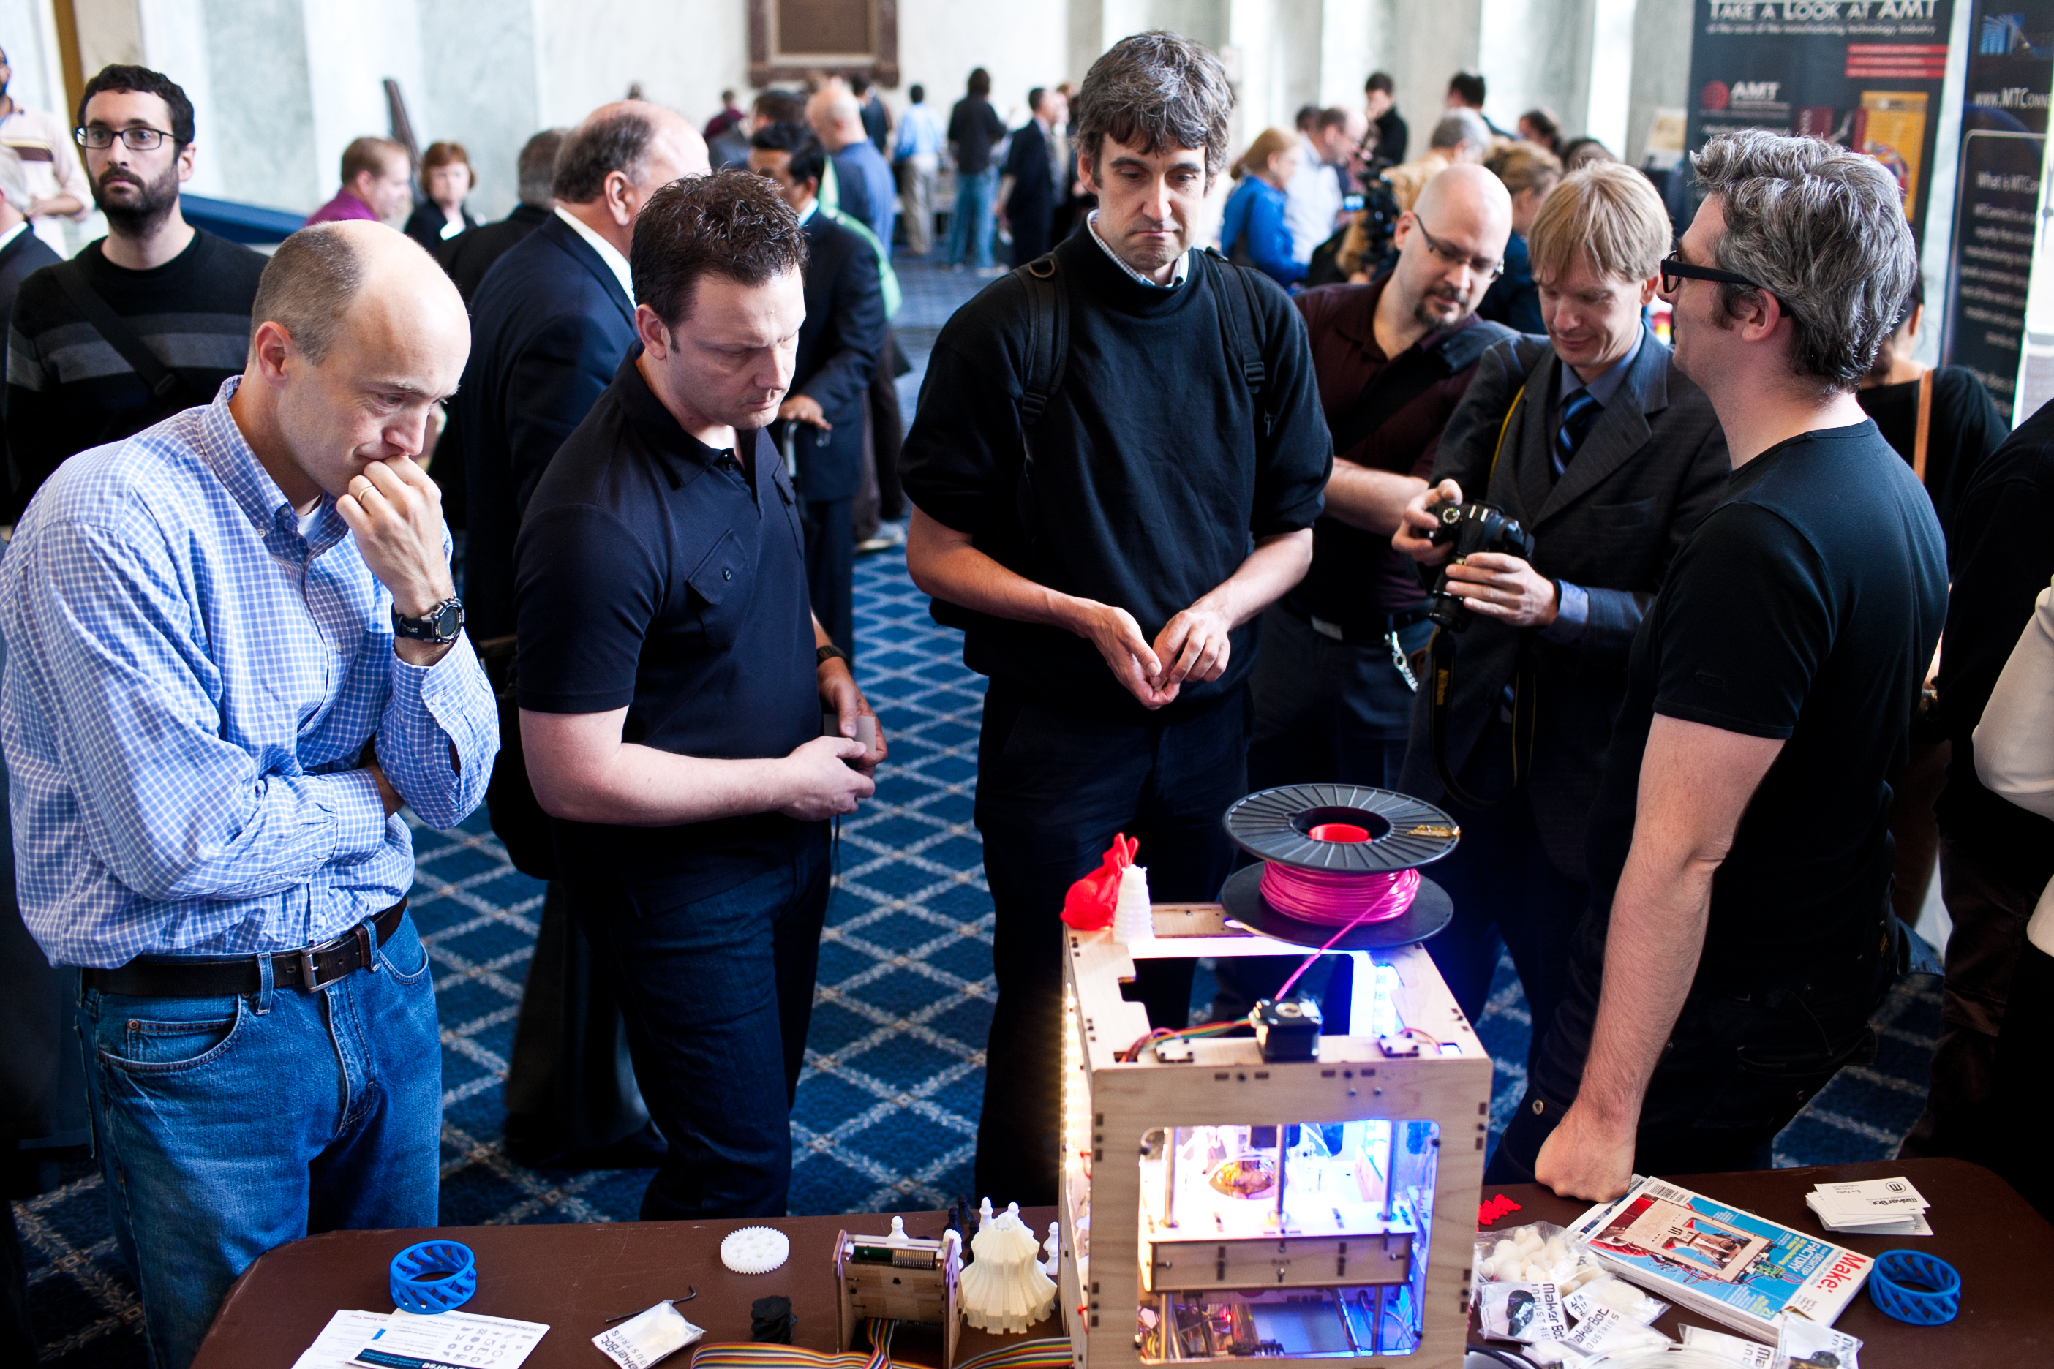

Slide 8
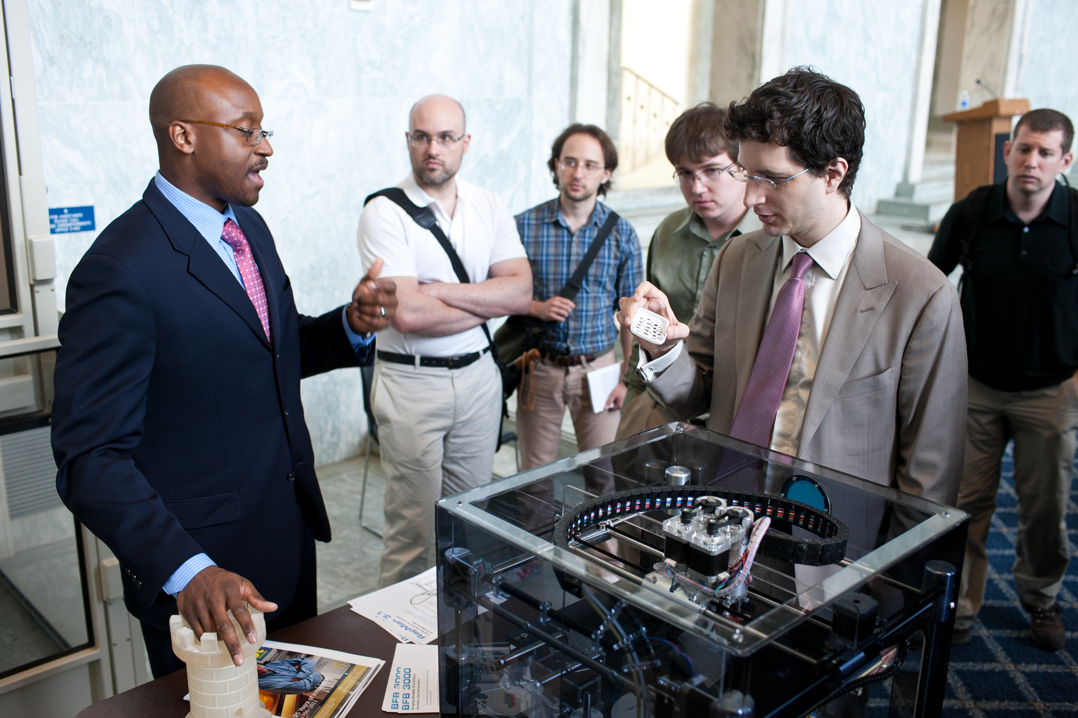

Slide 9
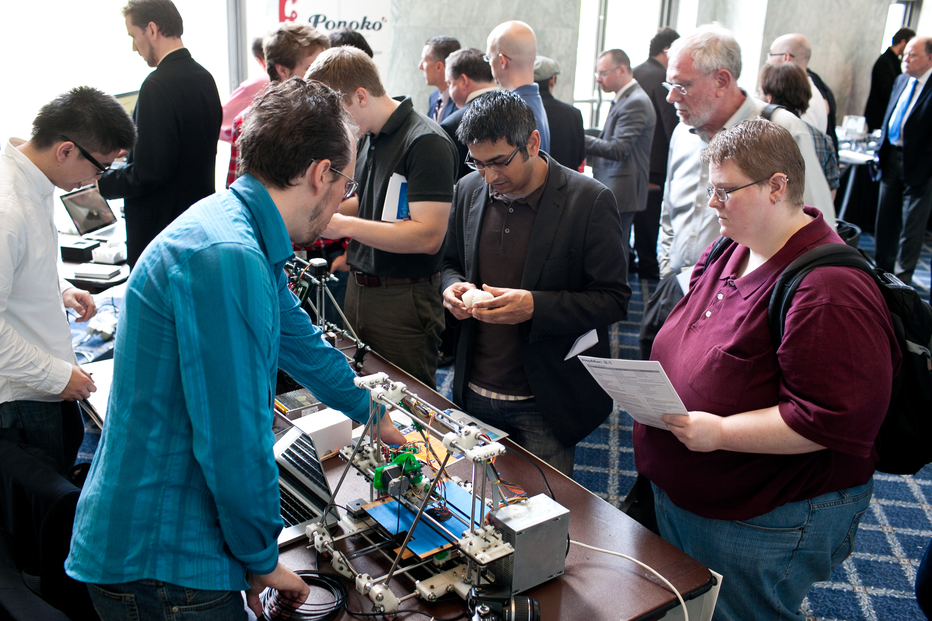

Slide 10
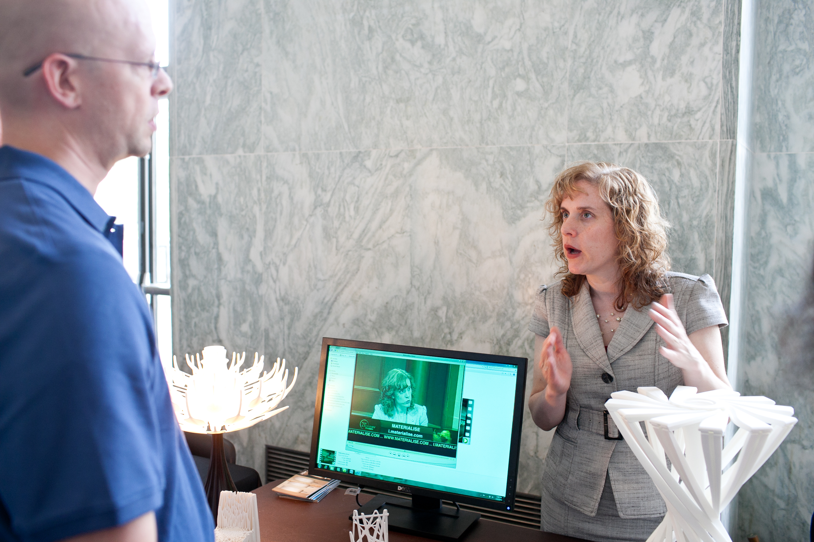

Slide 11
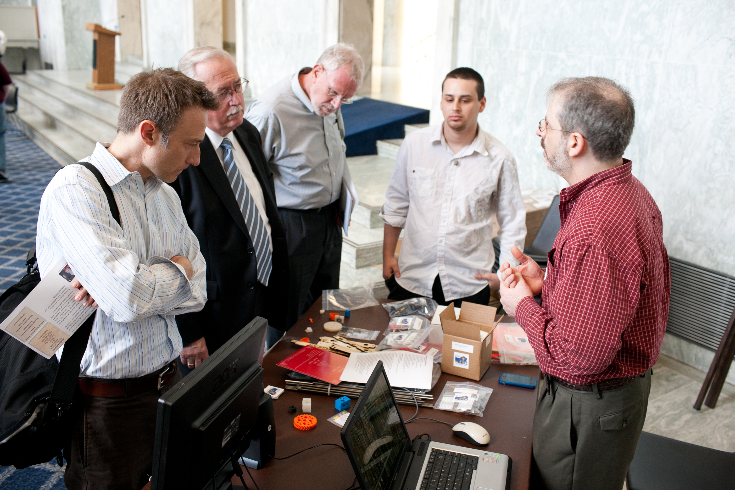

Slide 12
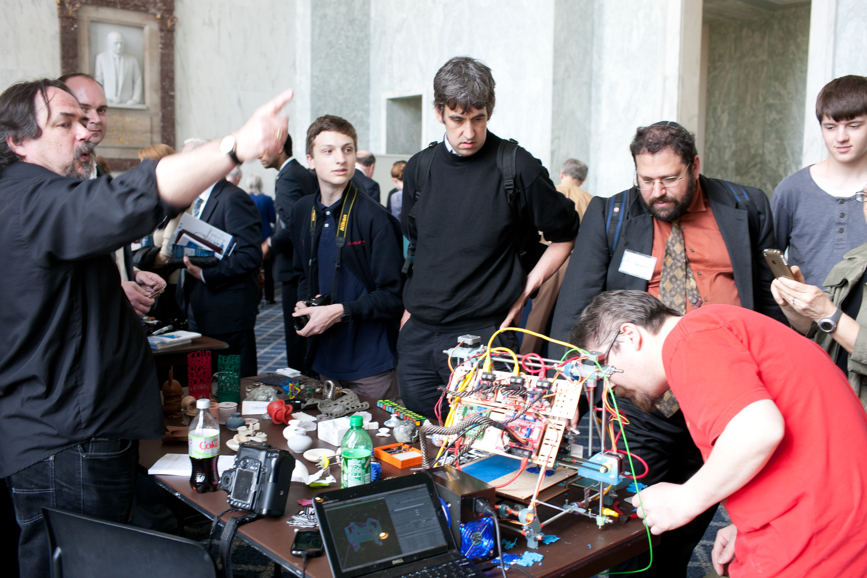

Slide 13
www.PublicKnowledge.org
mweinberg@publicknowledge.org
@mweinbergPK

